Slide 1
THREAD SYNCHRONIZATION

Slide 2
Synchronization in java is the capability to control the access of multiple threads to any shared resource
TYPES OF SYNCHRONIZATION
1) Mutual Exclusive
Synchronized method.
Synchronized block.
static synchronization.
2)Cooperation (Inter-thread communication in java)

Slide 3
MUTUAL EXCLUSIVE
Mutual Exclusive helps keep threads from interfering with one another while sharing data. This can be done by three ways in java:
BY SYNCHRONIZED METHOD
BY SYNCHRONIZED BLOCK
BY STATIC SYNCHRONIZATION

Slide 4
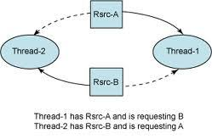
CONCEPT OF LOCK IN JAVA : 1. From java 5 the package 2.java.Util.Concurrent.Locks contains several lock implementations

Slide 5
JAVA SYNCHRONIZED METHOD
If you declare any method as synchronized, it is known as synchronized method.
Synchronized method is used to lock an object for any shared resource.
When a thread invokes a synchronized method, it automatically acquires the lock for that object and releases it when the thread completes its task.

Slide 6
SYNCHRONIZED BLOCK
Synchronized block is used to lock an object for any shared resource.
Scope of synchronized block is smaller than the method.
Syntax to use synchronized block:
synchronized (object reference expression) {
//code block
}

Slide 7
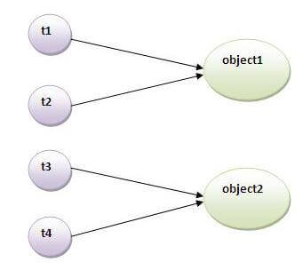
STATIC SYNCHRONIZATION
If you make any static method as synchronized, the lock will be on the class not on object

Slide 8
INTER-THREAD COMMUNICATION IN JAVA
(CO-OPERATION)
It is all about allowing synchronized threads to communicate with each other.
Main methods
wait()
notify()
notifyAll()

Slide 9
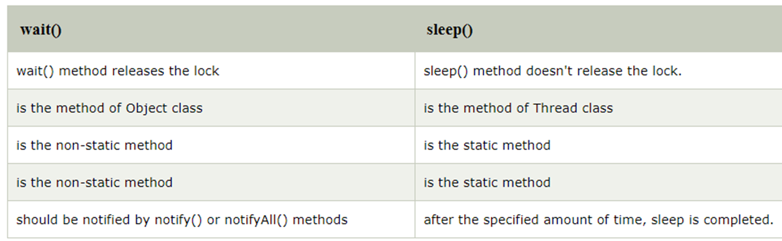
DIFFERENCE BETWEEN
wait() & sleep()
METHODS

Slide 10
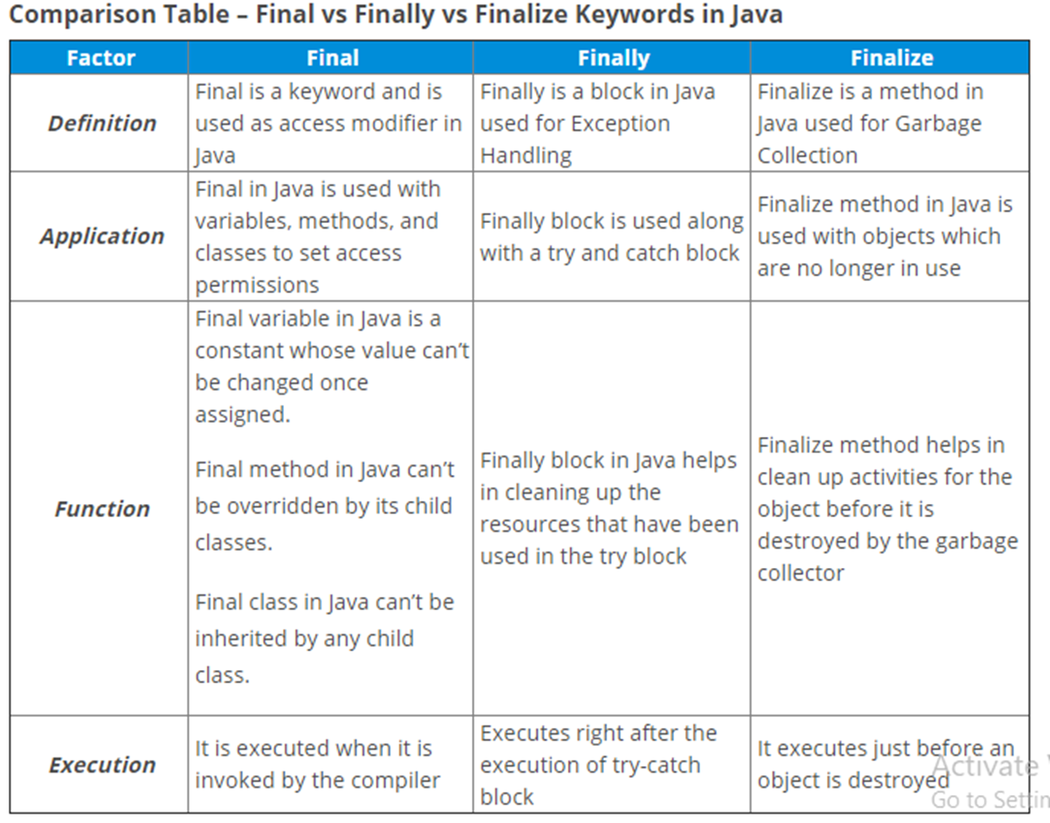

Slide 11
Examples

